Slide 1
Welcome Guests
Newark Morning Rotary
Discover Rotary Hour
May 29, 2019

Slide 2
What is Rotary?
It’s busy people,
just like you and me,
working to make life just a little bit better
for others here at home and around the world.

Slide 3
Rotary is ...
Clean drinking water for people …
Vaccinations for millions of children …
Schools and books for children …
Health care for mothers and babies …
Peace and conflict resolution in communities …
Food on the table of families …
… that we’ll never meet.

Slide 4
Rotary In the World

Slide 5
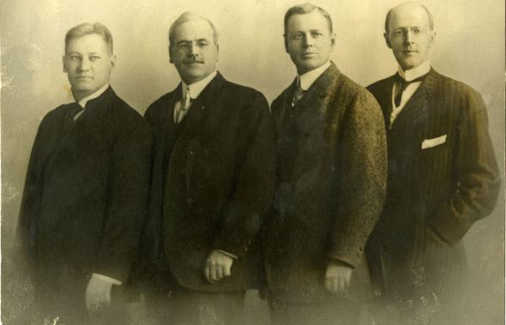
Our History – Paul Harris
Founded 1905
Chicago, IL
Paul Harris (& friends)
1st project:
Public Toilets

Slide 6
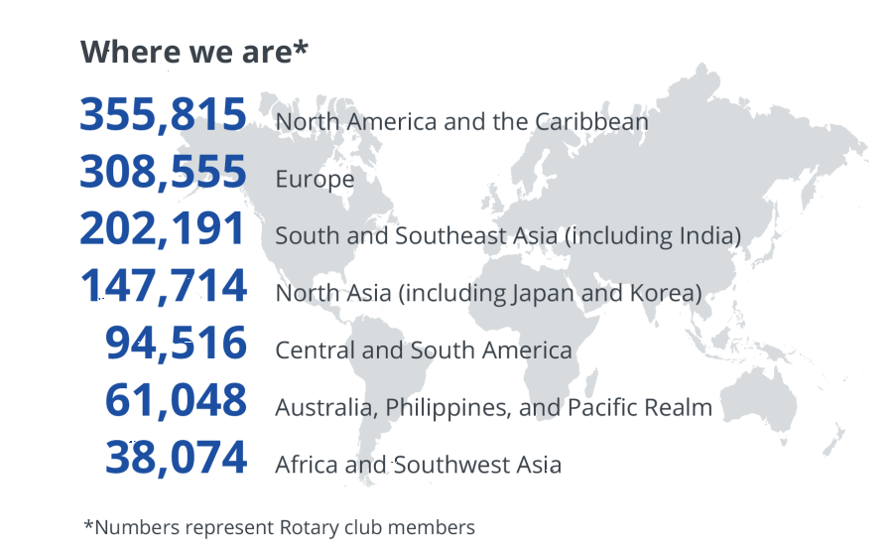
Our History – Rotary Today
Over 1.2 million members
35,000 global clubs
135 countries

Slide 7
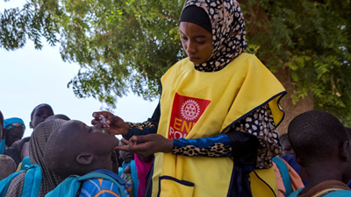
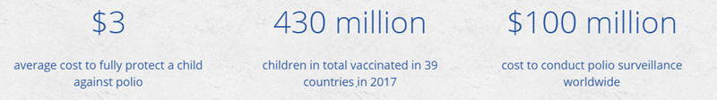
Our History – Polio Eradication
Working to Eradicate Polio for over 30 Years
START: 350,000 cases per year (1000 per day!)
NOW: 33 cases in 2018

Slide 8
Our History - The Rotary Foundation
Rotary’s philanthropic arm
Started in 1917 with $26.50
In 2007, the Bill and Melinda Gates Foundation pledged $2 for $1 match for Polio Plus
Spent over $3 billion on humanitarian efforts and scholarships

Slide 9

Our History – The Four Way Test

Slide 10
Newark Morning Rotary

Slide 11
Newark Morning Rotary
Celebrated 20th Anniversary in 2019
40+ Members of Varied Interests and Professions
Meet weekly on Thursdays from 7:00am - 8:15am

Slide 12
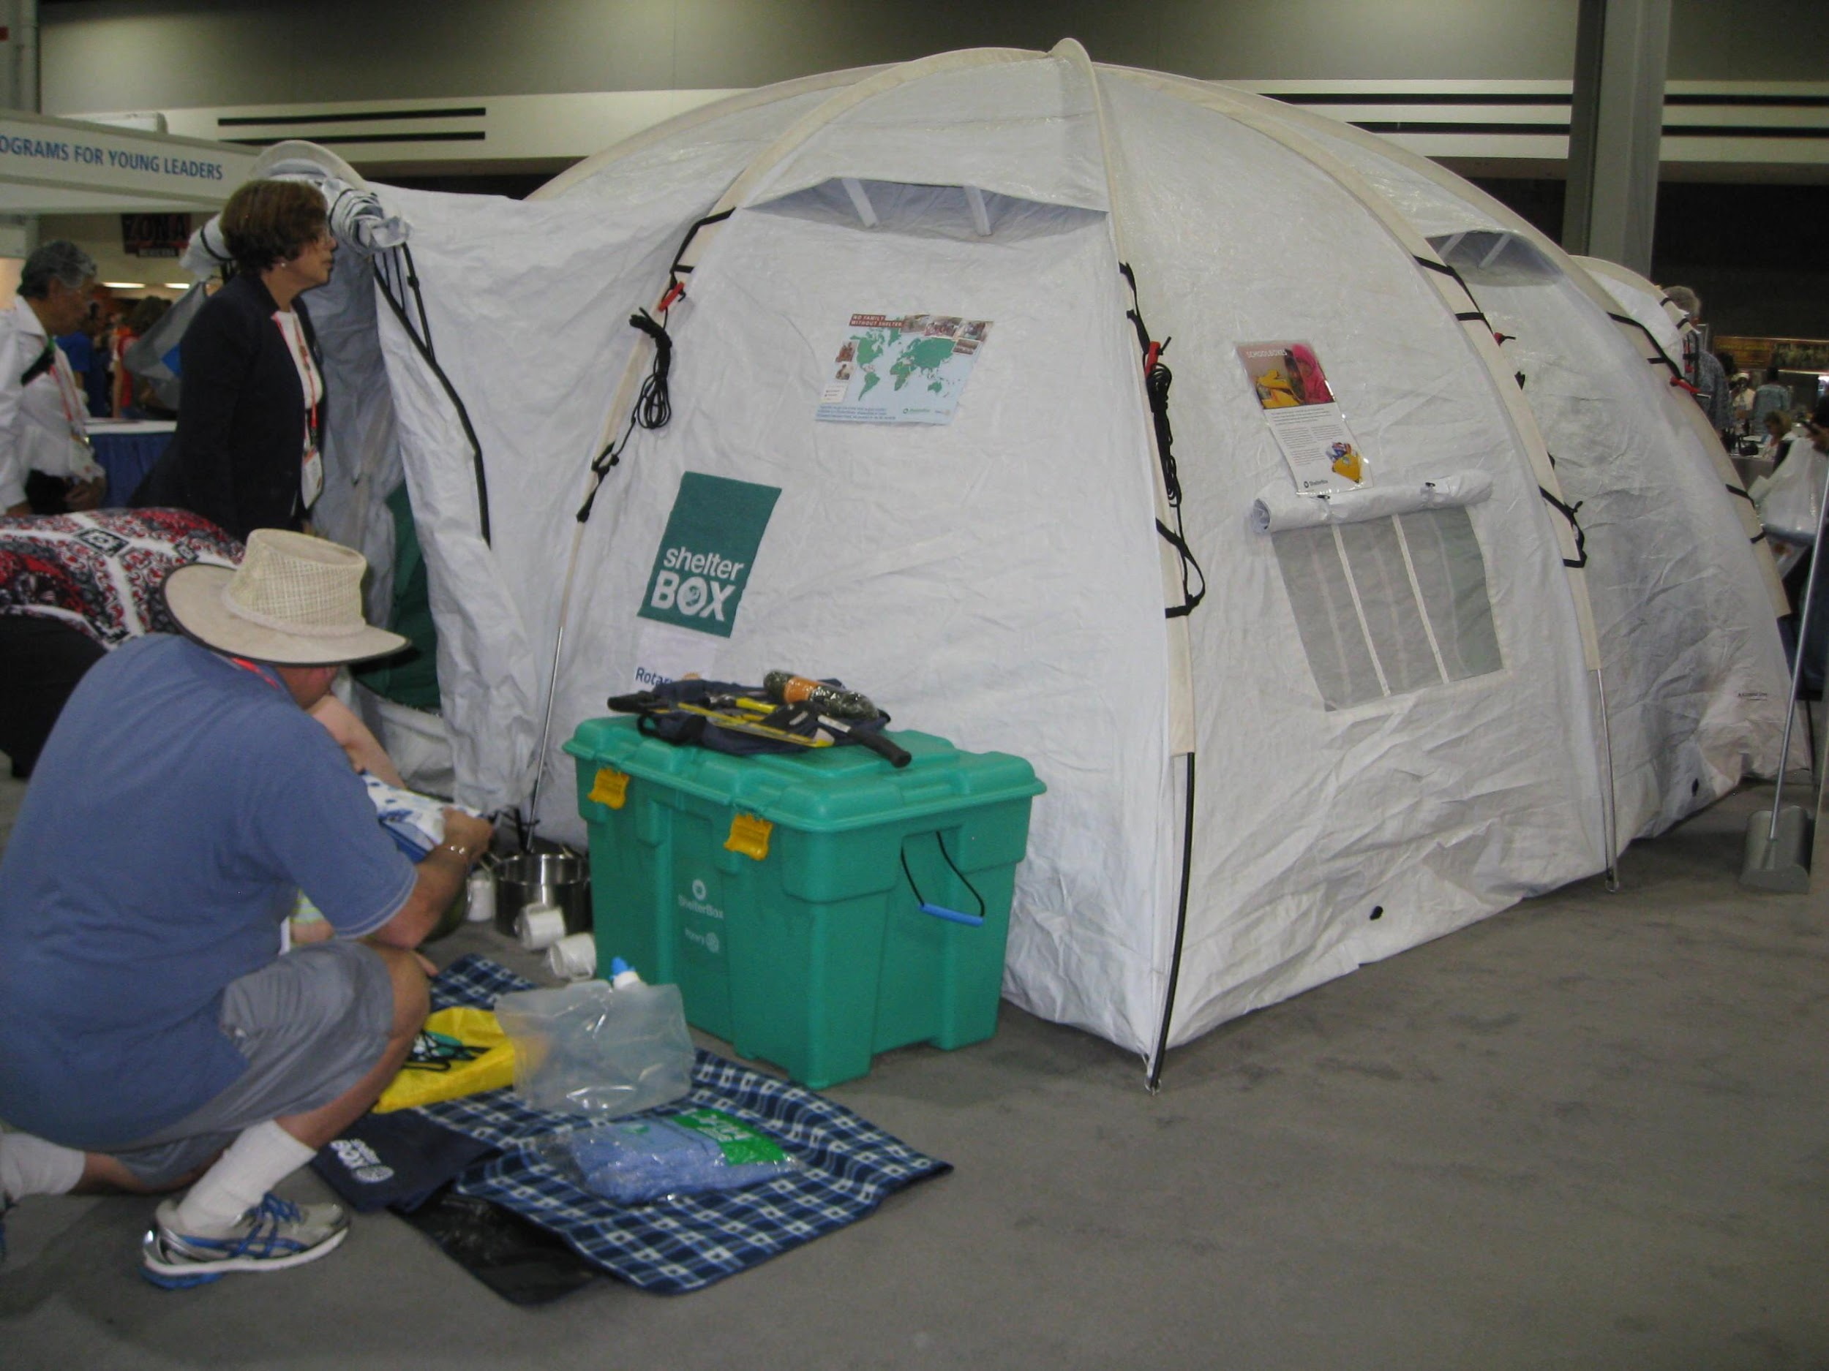
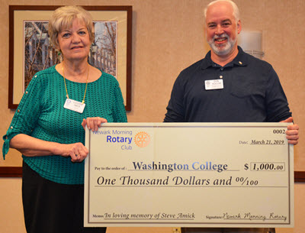
Dedicated to Serving the Community
We give Money when Vital…

Slide 13
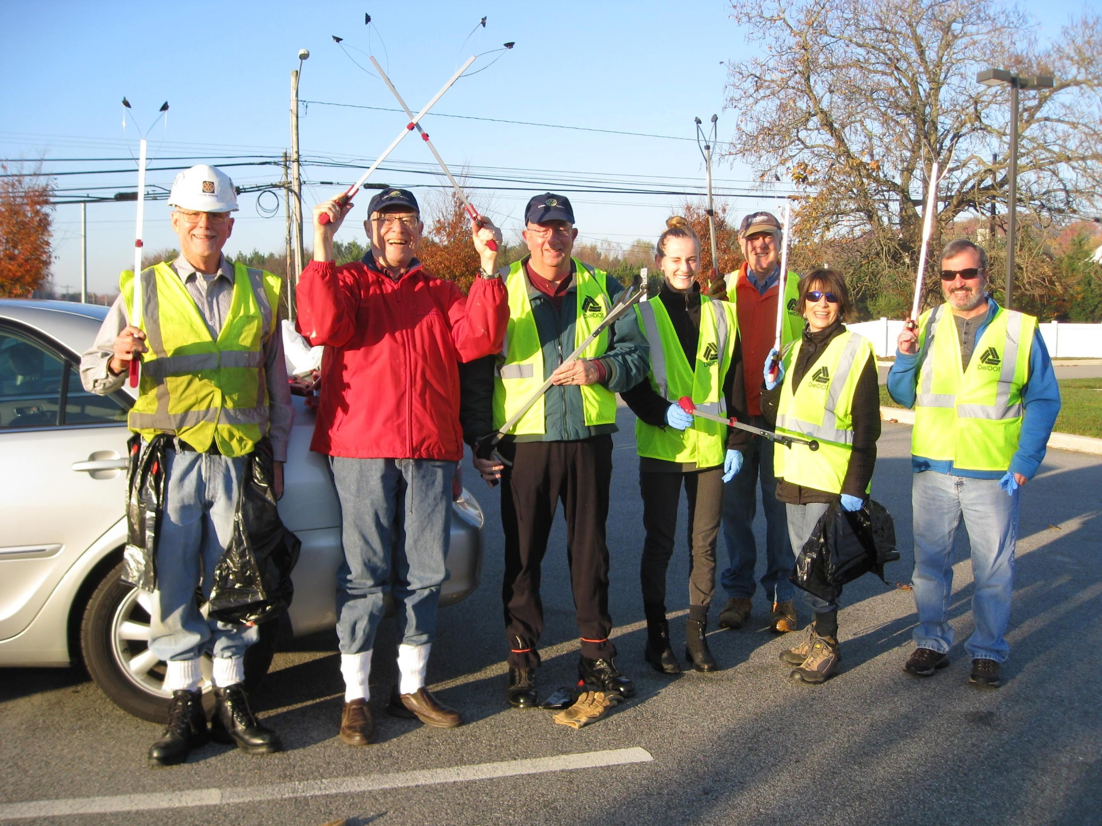
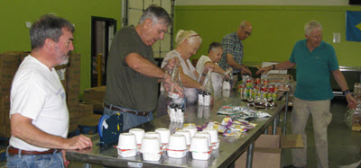
… and time when we can.

Slide 14
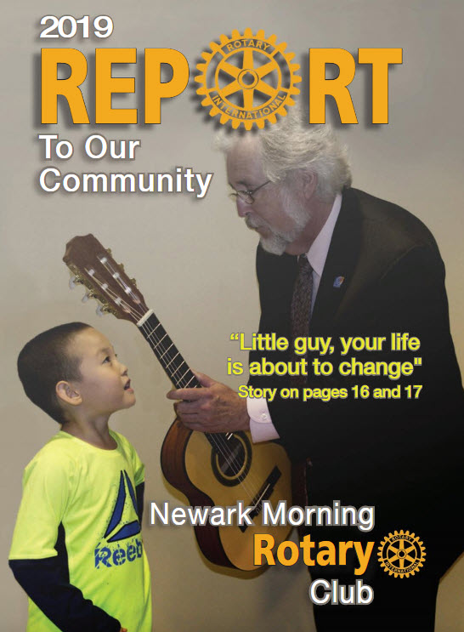
Report To Our Community
One HUGE Fundraiser per Year –
Report To Our Community
Nearly $700,000 Raised for Community
Service Projects
Money Spent on Humanitarian Projects:
  Locally, Regionally, Globally
Not One Penny Spent on Ourselves

Slide 15
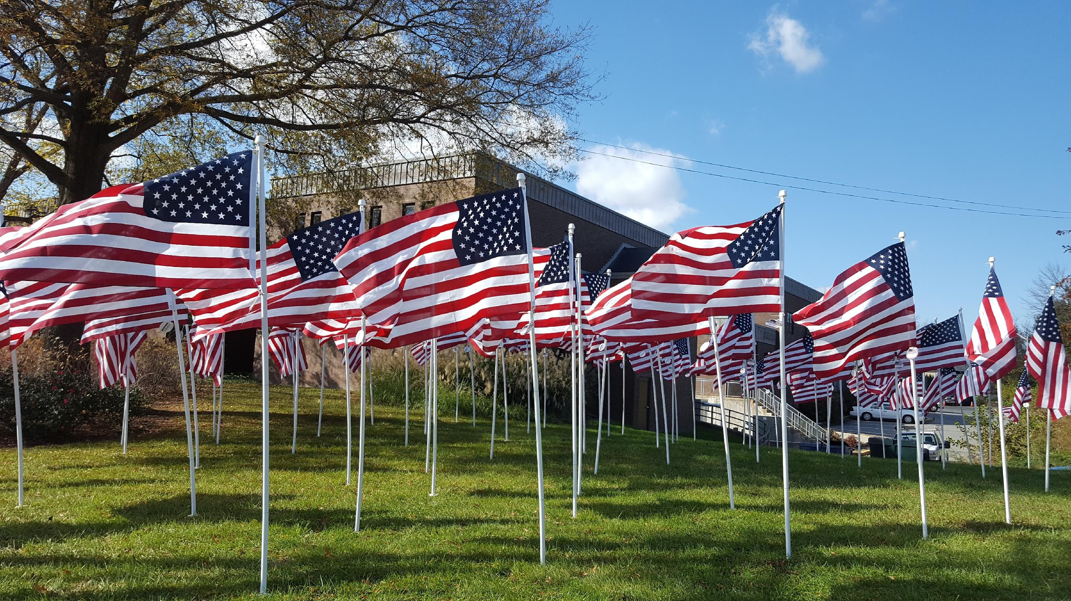
No Raffle Tickets, Pizza Kits, or ongoing sales

Slide 16
Newark Morning Rotary
Who are We at Newark Morning Rotary?
Men and Women, Ages 30 to 80
Working and Retired
40+ Members: Variety of Professions and Interests

Slide 17
We’re just like you …
Higher Education Clergy
Engineering Media
Law Flight Instructing
Real Estate Non-Profit
Financial Planning Hotel Management
Accounting Communications
Business Owners Retired
and more ...

Slide 18
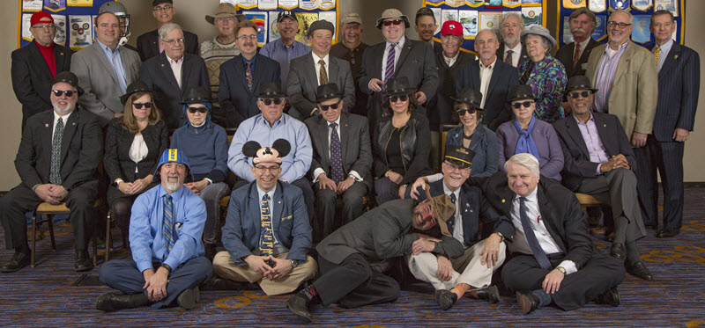
Newark Morning Rotary

Slide 19
Is This for Me?

Slide 20
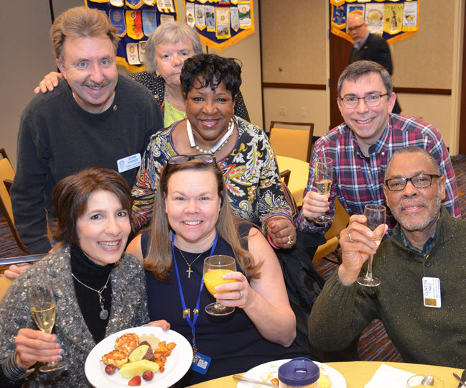
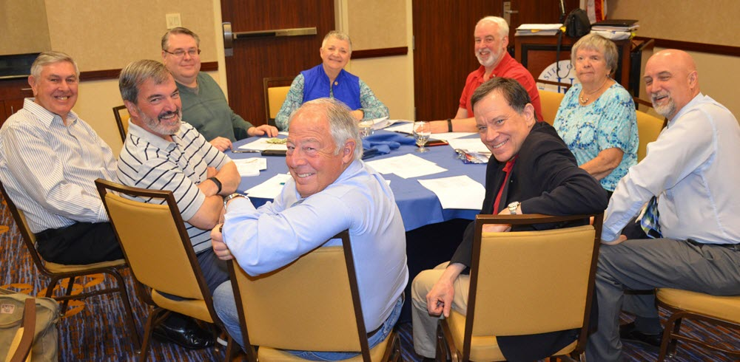
Is This for Me?
Thursday Mornings
7:00 am to 8:15 am
Come Dressed as You would for Your Work

Slide 21
Is This for Me?
Do you enjoy
working with others to solve problems?
helping those in need?
being part of something larger than yourself?
finding time when you thought you had none?

Slide 22
Is This for Me?
Membership Types
Regular Attend most meetings, Standard fees
Corporate Shared attendance responsibilities
Service Attend 1 meeting per month, 26 Rotary
service hours per year, reduced fees
Student Attend most meetings, 26 Rotary service
hours per year, reduced fees

Slide 23
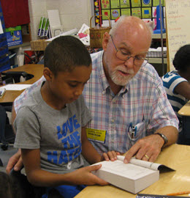
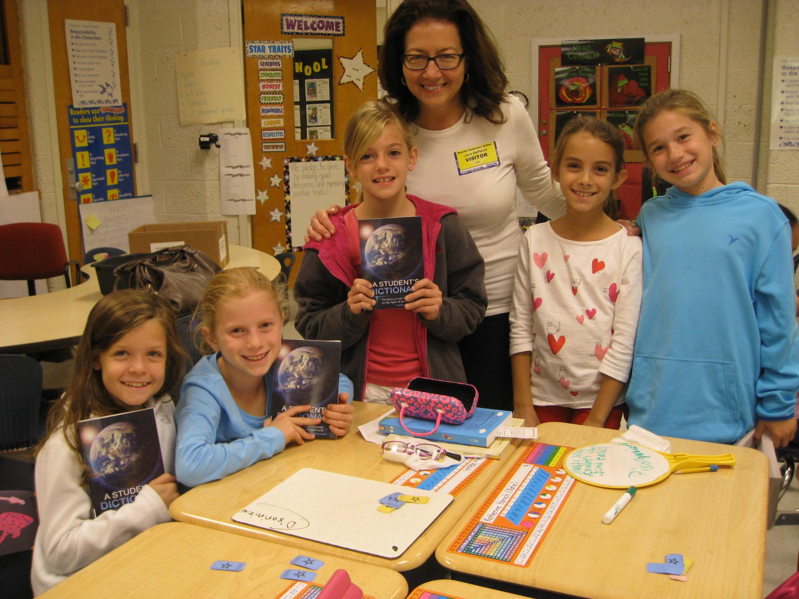
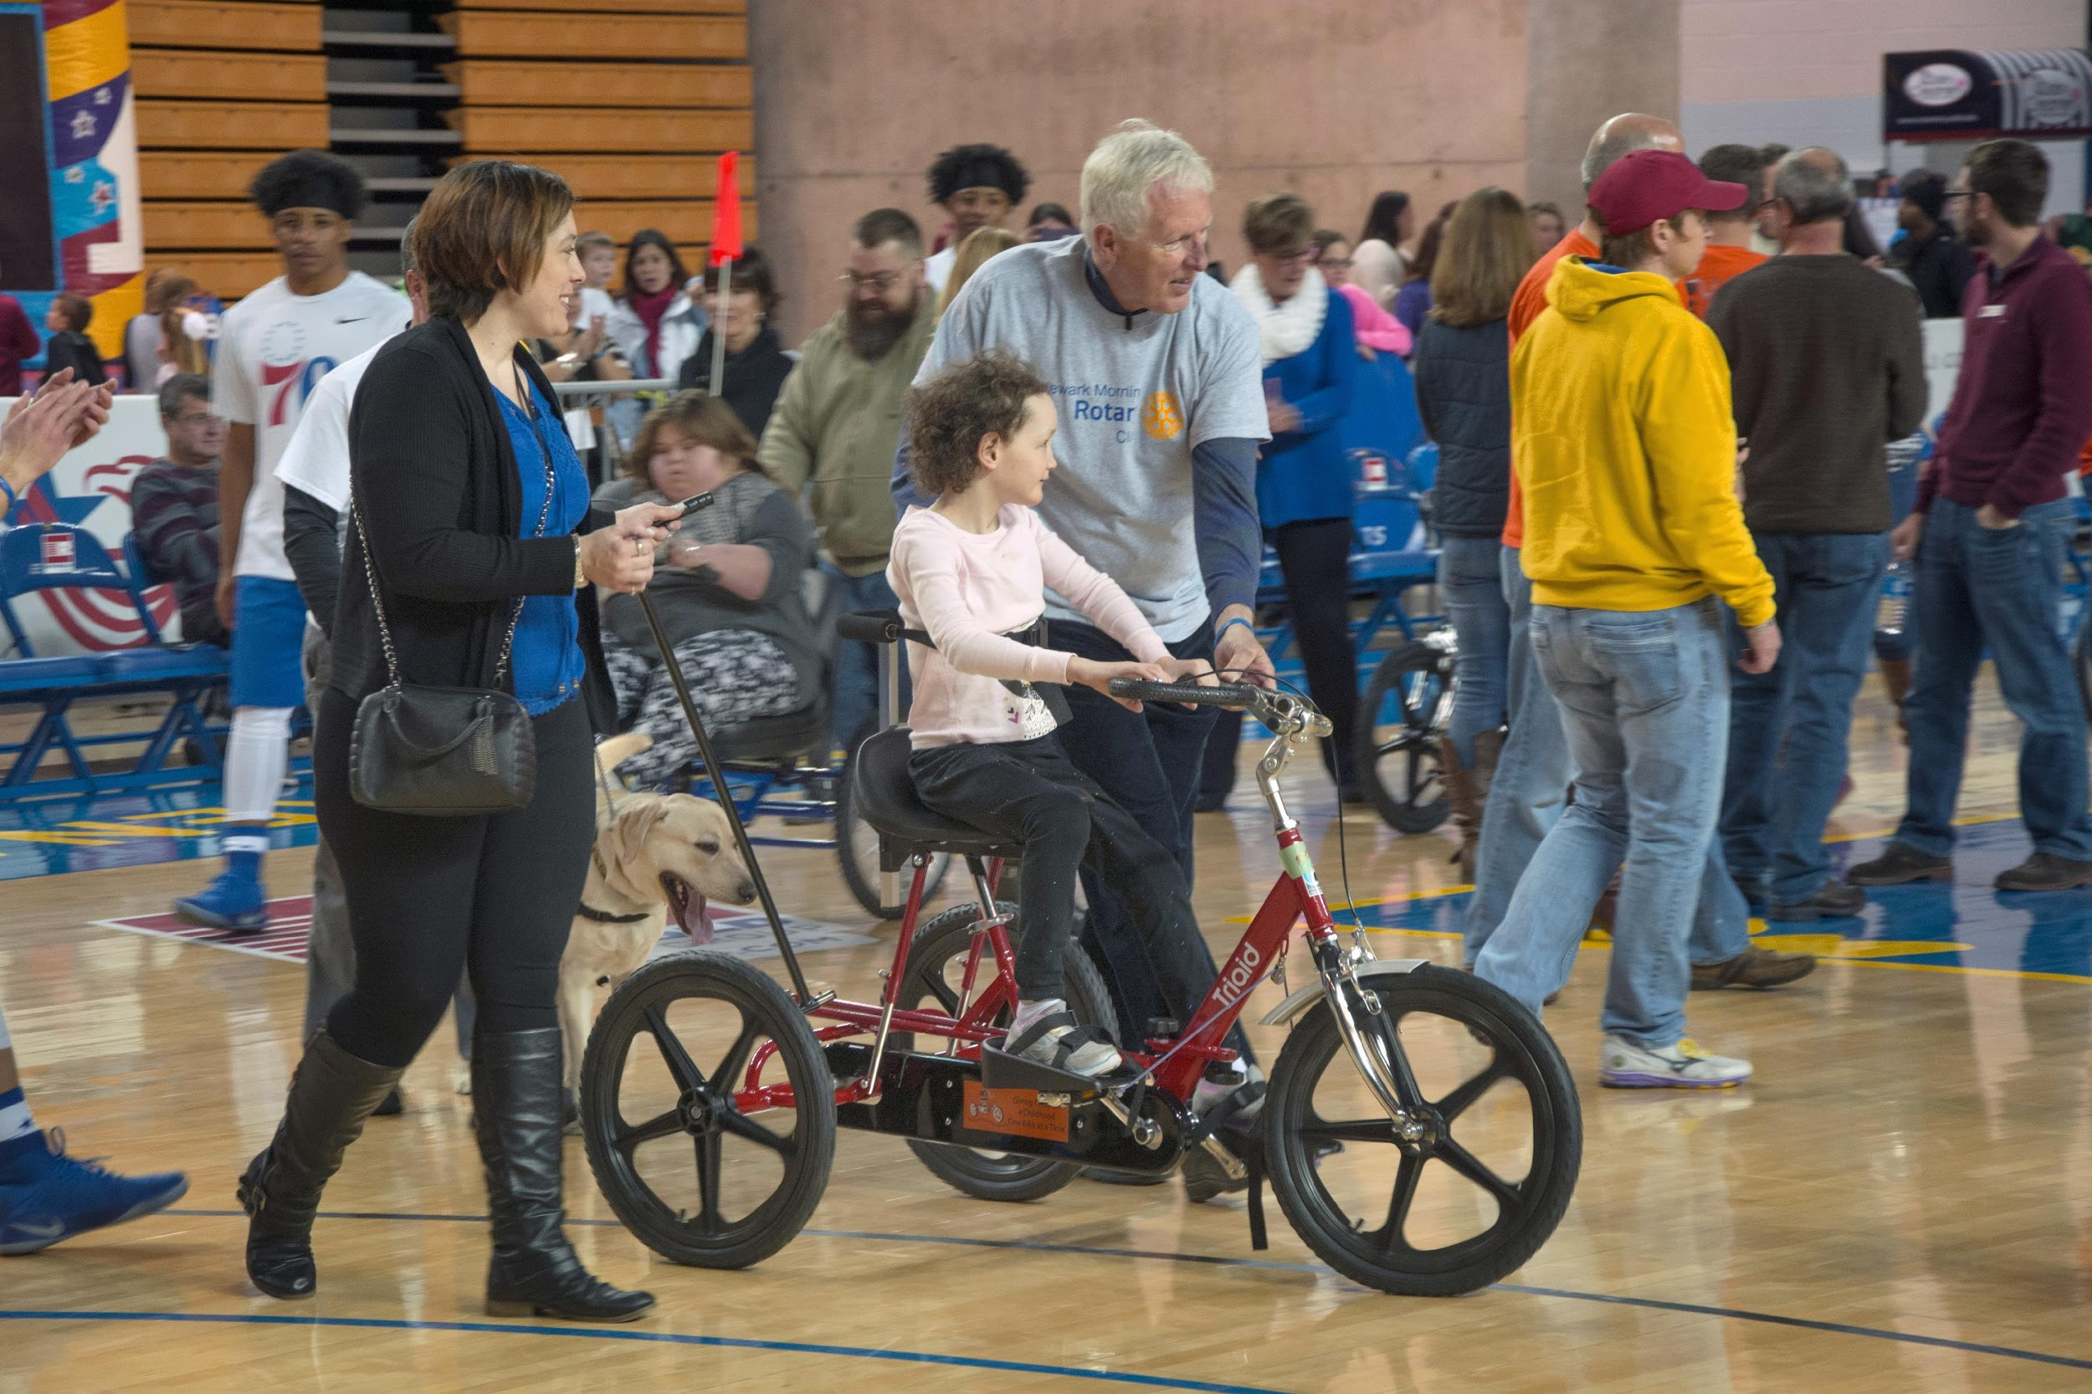
Is This for Me?
Can you see yourself doing this?

Slide 24
Is This for Me?
Why did We become Rotarians?
for the Opportunity to Help Others
for Fellowship and Fun
to Develop Professional Relationships

Slide 25
Is This for Me?
Is This for You?
Join Us for a Meeting, and then
Answer for Yourself

Slide 26
Is This for Me?
Questions??

Slide 27
Thank You for Attending!
Newark Morning Rotary
Discover Rotary Hour
May 29, 2019

